Slide 1
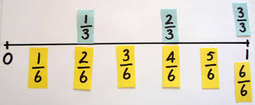
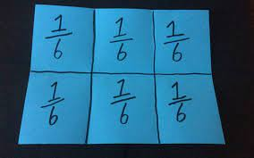
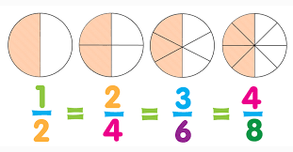
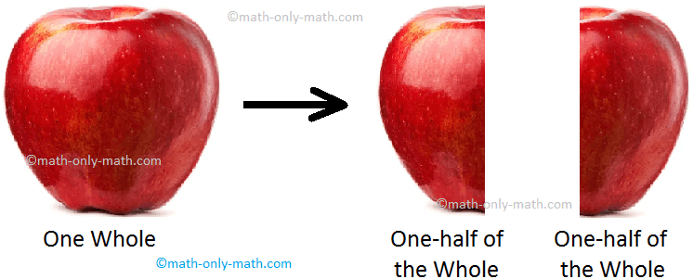
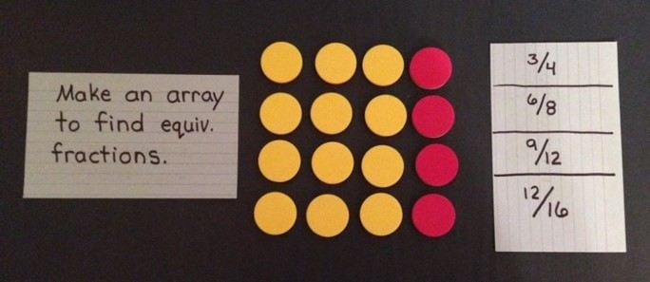
The Joy of Fractions Years 4-8

Slide 2
The Date Game
1 12 22
Using the numbers/digits above, find an arithmetic relationship between the numbers.

Slide 3
Which One Doesn’t Belong

Slide 5
Three Models for Fractions
Area
Set
Number Line

Slide 6
Area Model (fraction of the whole)
What fraction of the large square is shaded red?

Slide 7
Set Model (fraction of the objects)
What fraction of the squares are shaded red?

Slide 8
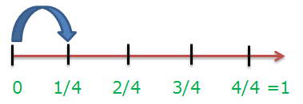
Number Line Model (location/distance)
Where is ¼ on the number line?

Slide 9
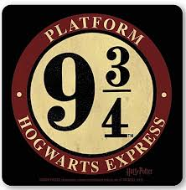
Number Line Model (location/distance)

Slide 10
Multiple Representation of Fractions

Slide 11
Myer Maths: Areas of Focus
Choral Counting
Maths Academic Language Sentence Frames
Mental Maths
Fractions
Money

Slide 12
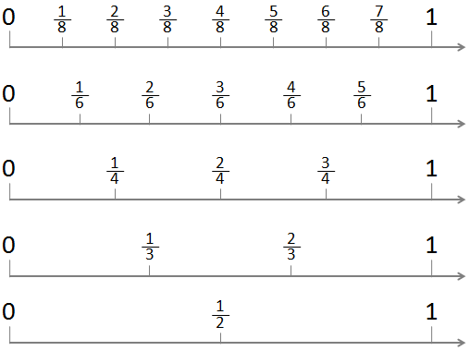
Oral Language: Choral Counting

Slide 13
Oral Language: Sentence Frames
One-half of the square is red.
One-half of the square is blue.
One-third of the square is gold.
Two-thirds of the square is green.

Slide 14
Oral Language: Fraction Names
One-Quarter or One-Fourth?
One-Half
One-Third
One-Fourth
One-Fifth
One-Sixth
One-Seventh
One-Eighth
One-Ninth
One-Tenth

Slide 15
Mental Maths with Fractions
What is double 20?
What is one-half 40?
What is double 12?
What is double 24?
What is one-half 48?
What is one-half 24?

Slide 16
Mental Maths with Fractions

Slide 17
Fraction Number Sense
What can you say about __________?
Sense-making sequences of fractions.
Are they getting closer to 0 or to 1?
Use “numerator” and “denominator” in what you say.

Slide 18
What can you say about __________?

Slide 19
What can you say about __________?

Slide 20
What can you say about __________?

Slide 21
Sense Making Strategy for Fraction Division
Why is it important for students to learn fraction division?
Why do we find common denominators for addition and subtraction but not for multiplication and division of fractions?

Slide 22
Sense Making Strategy for Fraction Division

Slide 23
Sense Making Strategy for Fraction Division
When is the last time you had a situation in your life when you needed to do fraction arithmetic with 37 as the denominator?

Slide 24
Sense Making Strategy for Fraction Division
Let’s agree on the following
A fraction is a way to write a division problem.
Arithmetically, dividing 10 tons by 5 tons is the same as dividing 10 Kg by 5 Kg.
In other words, dividing 10 whatevers by 5 whatevers is 10 divided by 5 if the whatevers are the same.

Slide 25
Fraction Division with Common Denominators

Slide 26
Fraction Division with Common Denominators

Slide 27
Fraction Division with Common Denominators

Slide 28
Ancient Egypt and Unit Fractions
In ancient Egypt, all fraction arithmetic was performed using unit fractions.
Every fraction can be written as a sum of unique unit fractions in an infinite number of ways!

Slide 29
Egyptian Fractions

Slide 30
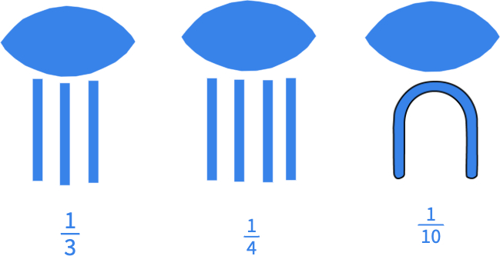

Slide 31
Fraction Subtraction Practice: Egyptian Fractions

Slide 32
Fraction Subtraction Practice: Egyptian Fractions

Slide 33
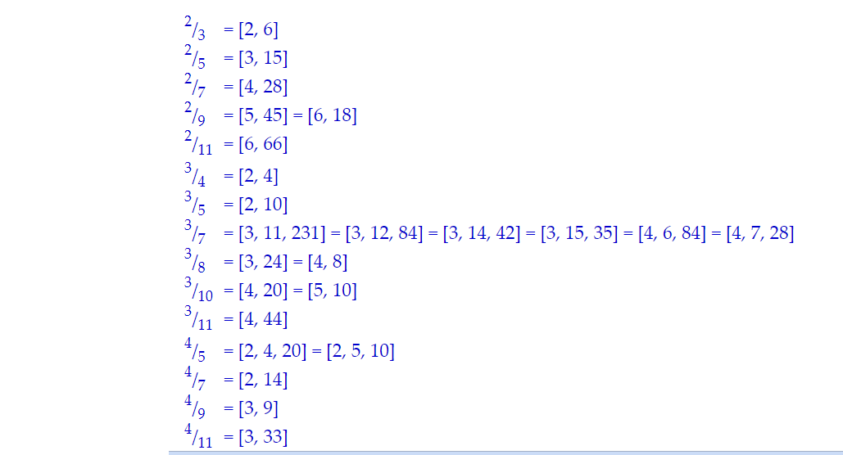
Shortest Egyptian Fractions
https://r-knott.surrey.ac.uk/Fractions/egyptian.html

Slide 34
Tim Gill
Director, Instructional Support Services
Konocti Unified School District
tim.gill@konoctiusd.org

