Slide 1
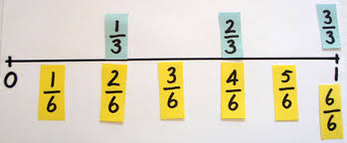
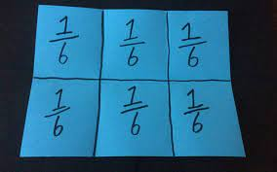
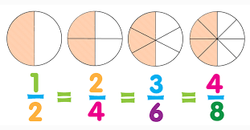
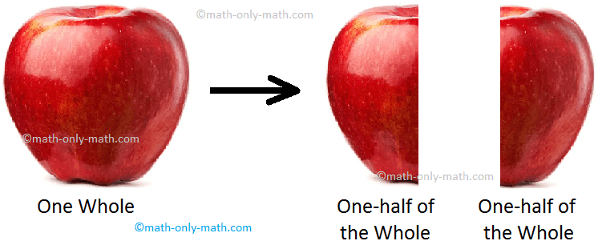
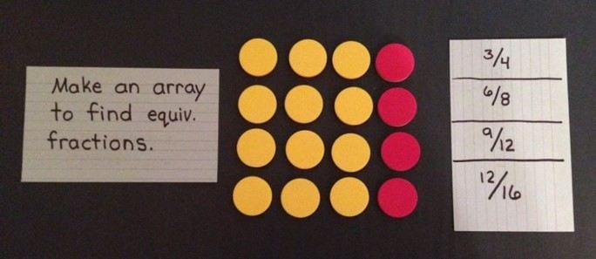
The Joy of Fractions Years K-3

Slide 2
The Date Game
30 11 22
Using the numbers/digits above, find a arithmetic relationship between the numbers.

Slide 3
Which One Doesn’t Belong

Slide 5
Three Models for Fractions
Area
Set
Number Line

Slide 6
Area Model (fraction of the whole)
What fraction of the large square is shaded red?

Slide 7
Set Model (fraction of the objects)
What fraction of the squares are shaded red?

Slide 8
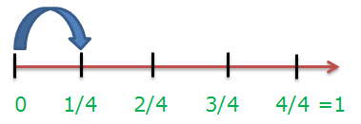
Number Line Model (location/distance)
Where is ¼ on the number line?

Slide 9
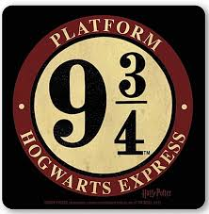
Number Line Model (location/distance)

Slide 10
Multiple Representation of Fractions

Slide 11
Myer Maths: Areas of Focus
Choral Counting
Maths Academic Language Sentence Frames
Mental Maths
Fractions
Money

Slide 12
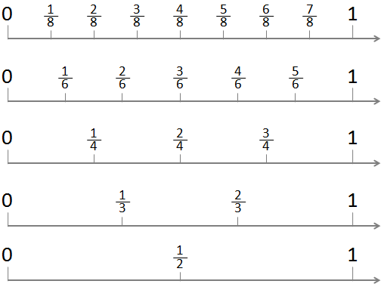
Oral Language: Choral Counting

Slide 13
Oral Language: Sentence Frames
One-half of the square is red.
One-half of the square is blue.
One-third of the square is gold.
Two-thirds of the square is green.

Slide 14
Oral Language: Fraction Names
One-Quarter or One-Fourth?
One-Half
One-Third
One-Fourth
One-Fifth
One-Sixth
One-Seventh
One-Eighth
One-Ninth
One-Tenth

Slide 15
Mental Maths with Fractions
What is double 2?
What is one-half 4?
What is double 3?
What is double 6?
What is one-half 12?
What is one-half 6?

Slide 16
Fraction Number Sense
More or less than one-half
Choose a question for students that has only two possible responses.
Example: Do you have long hair or short hair?
Students move into the two groups.
Determine which group is “more than one-half” and which is “less than one-half”.
Use sentence frames to express the results.

Slide 17
More or Less than One-Half
More than half of the students have _______ hair.
Less than half of the students have _______ hair.
If it isn’t obvious which group has more or less members, use one-to-one correspondence to make the determination.

Slide 18
Fraction Number Sense

Slide 19
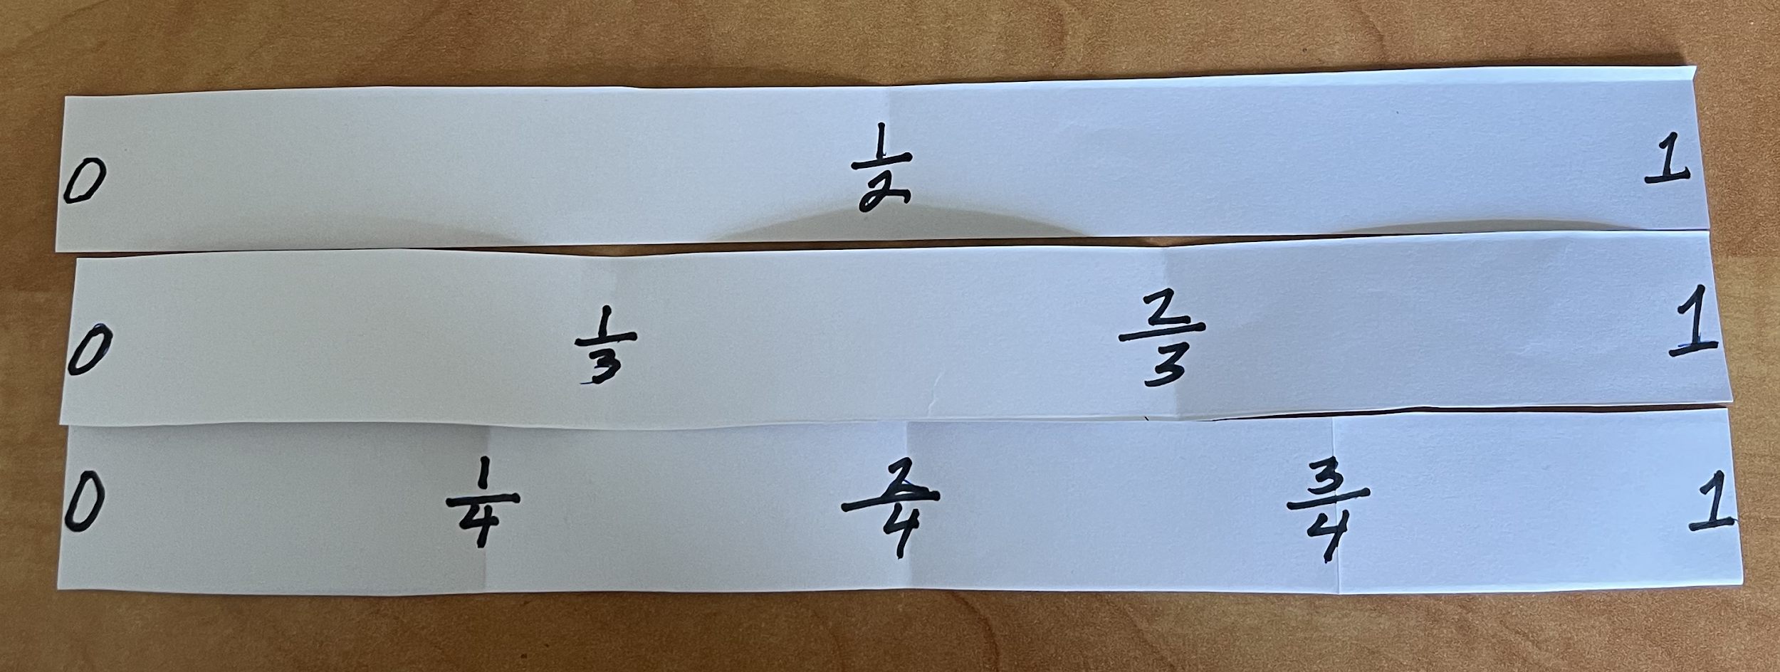
Anchors: Zero, One-Half, One

Slide 20
Anchors: Zero, One-Half, One

Slide 23
Tim Gill
Director, Instructional Support Services
Konocti Unified School District
tim.gill@konoctiusd.org

